Slide 1
D-311 Unit 6: Initial Attack / Incident Support

Slide 2
Objectives
Define the closest forces concept for incident support.
Describe initial attack and extended attack incident resource support.
Describe initial attack ordering procedures.
Describe what an agreement is and when it may be necessary.

Slide 3
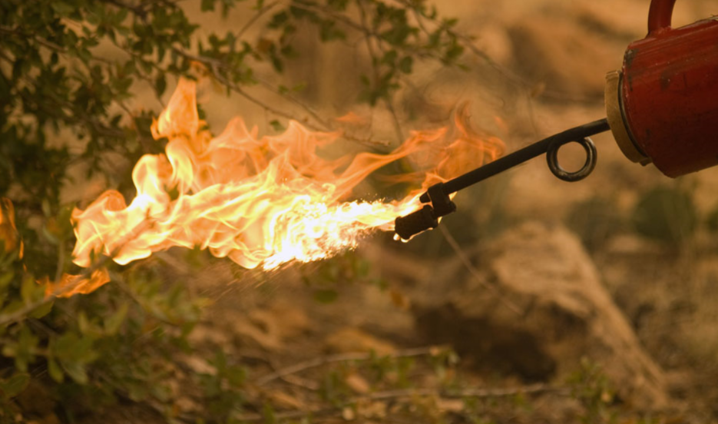
Closest Forces Concept
Dispatching the nearest available initial attack suppression resources, regardless of which agency they belong to, to a fire incident.
The cost-effective coordination of emergency resources for all incidents within the dispatching area.

Slide 4
Incident Resource Support
Once the local resources are no longer available, how will the initial attack dispatcher obtain the following resources?
Handcrews?
Additional Aircraft?
Equipment?
Supplies?
Overhead?
Services?

Slide 5

Interagency Sources
Federal
State
Cooperators
Contractors
EERA
Incident Only Agreements
Other

Slide 6
Agreements
Host Agency IBA
Host Agency Admin Unit
VIPR / DPL
Local Agreements
EERAs
Land Use
Other

Slide 7
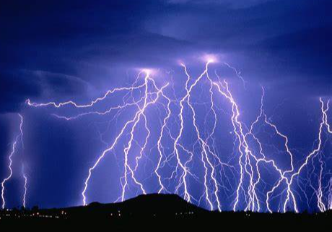
Exercise
Lightning Round

Slide 8
Summary
Define the closest forces concept for incident support.
Describe initial attack and extended attack incident support.
Describe initial attack ordering procedures.
Describe what an agreement is and when it may be necessary.
Notes:
Guides and Key
The presentations and instructor guides include notes to aid facilitators in instruction.
Key
Indicates an action for the instructor to take.
Indicates topics and information for the facilitator to use as they see fit.
Example Notes
Review unit objectives.
Exercise
Advise participants that the next few slides will introduce common terms that describe parts of a fire.
Pre-Video Discussion
In this scenario, firefighters have arrived on scene of a new fire. They are gathering and communicating their situational awareness of the current fire behavior.
Play Video
Title Basic Fire Terminology
Summary State the summary
Time (02:20)
Audio
Post-Video Discussion
This unit will discuss many of these terms in more detail.
Question: Identify this fire behavior.
Answer: Torching
Note to Instructor
The fuel types listed on this slide will be discussed in detail in Unit 2.
List Level 1
List Level2
Example
Example
List Level 1
List Level 1

